Slide 1
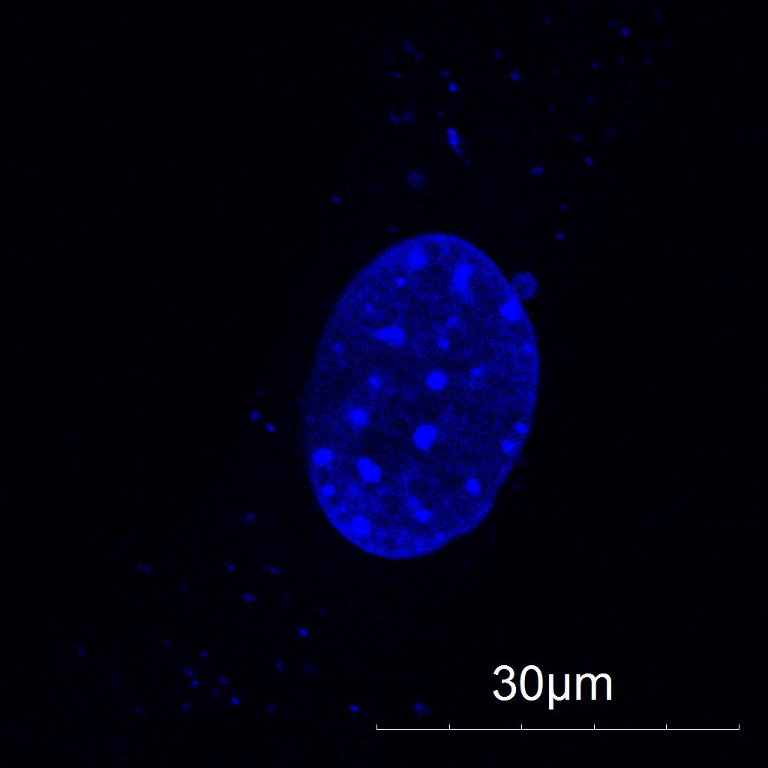
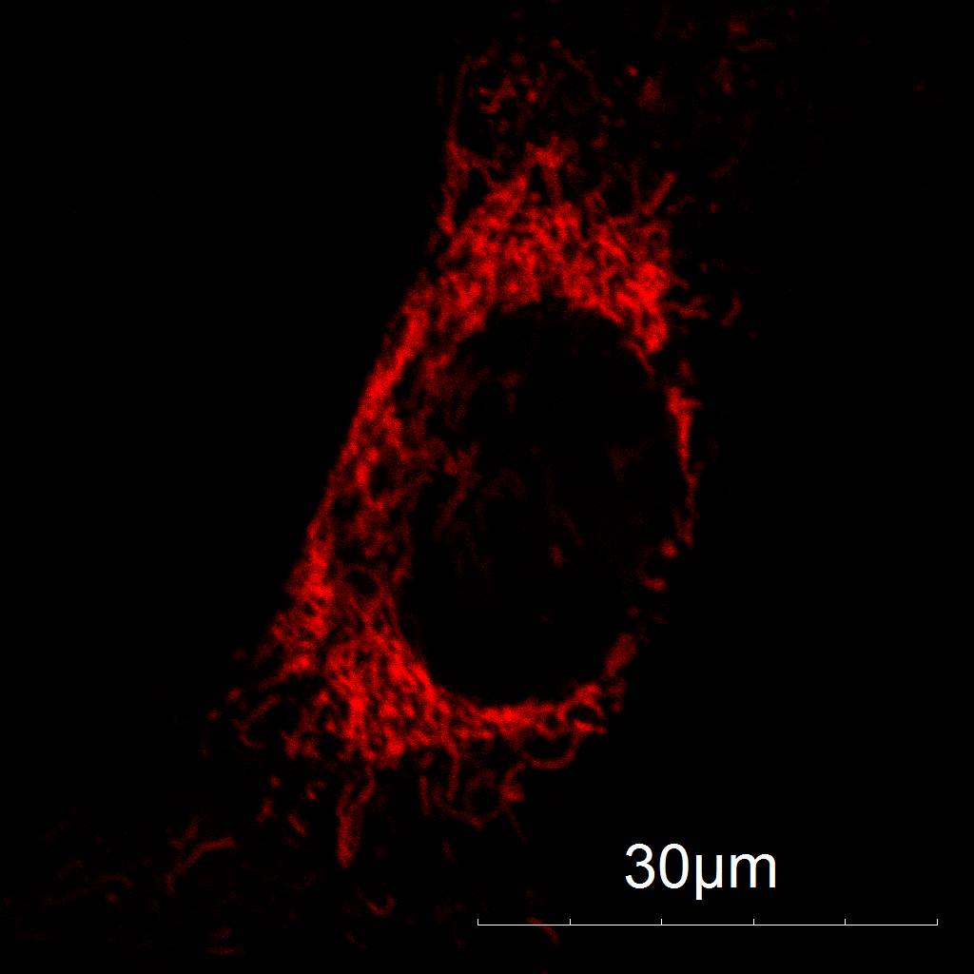
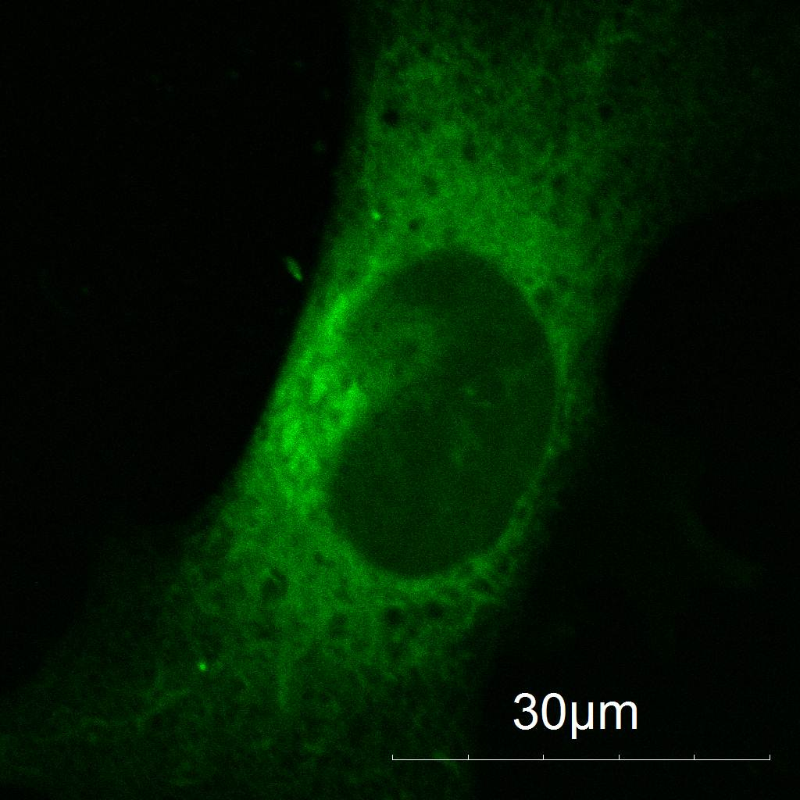
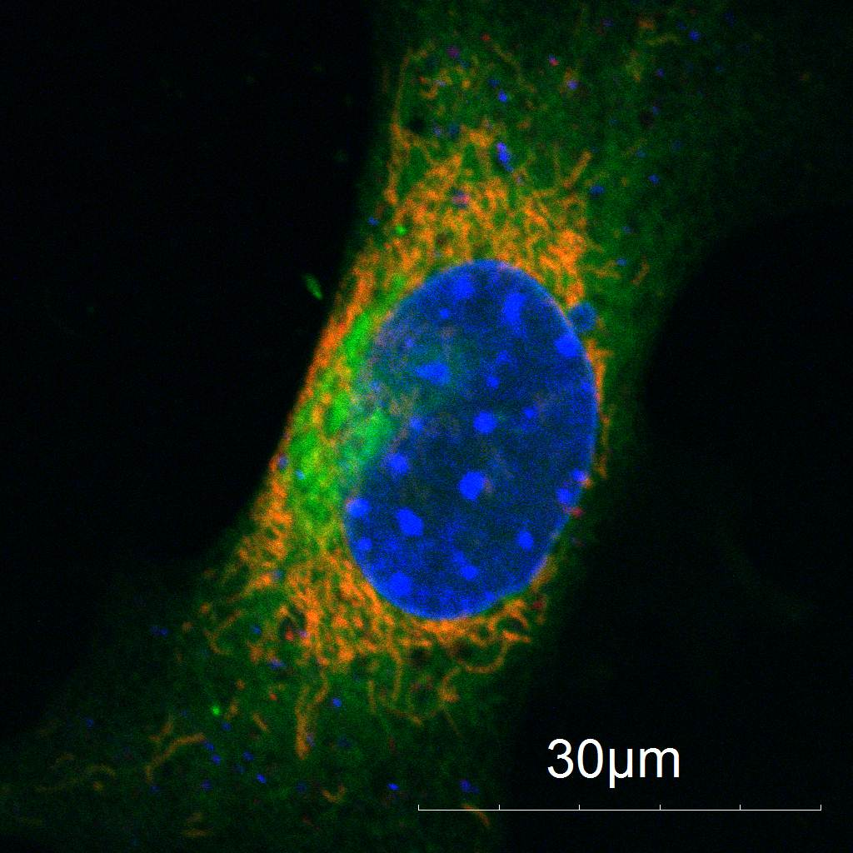
Co-localization of DSSQ1 with TMRM in NIH 3T3 Cells with TMRM
A
B
NIH 3T3 cells were incubated for 30min in Hoechst, Tetramethylrhodamine (TMRM), and DSSQ1. Images of the live cells were taken on a Confocal Microscope. A is Hoechst a nuclear dye. B is TMRM a mitochondrial dye. C is DSSQ1 which stains the entire cell green. D is composite image of all three dyes . Co-localization can be seen through the overlap of red and green colors. All images were taken under the same settings.
C
D
Notes:
DSSQ goes to mitochondria

Slide 2
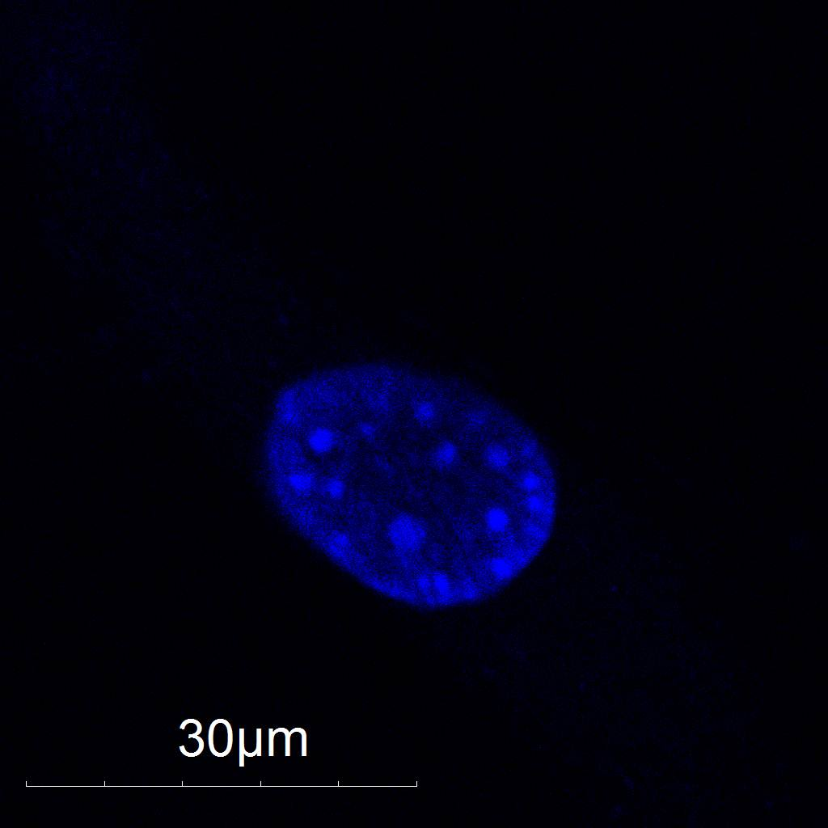
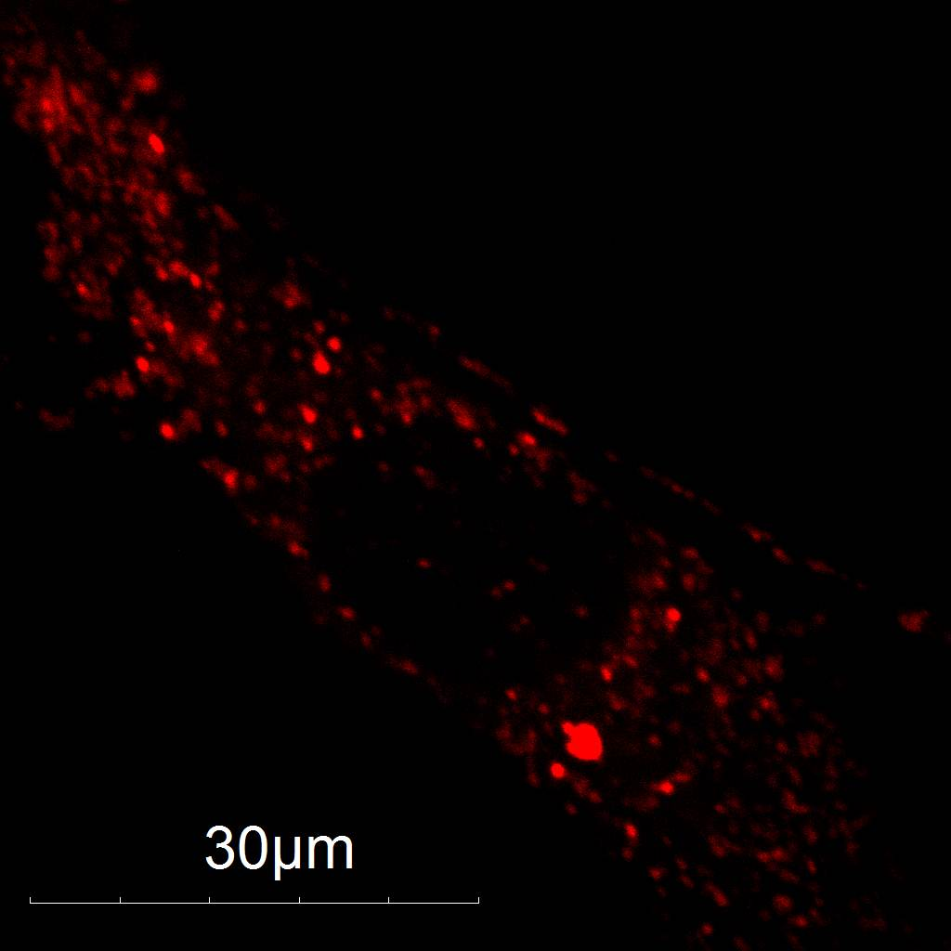
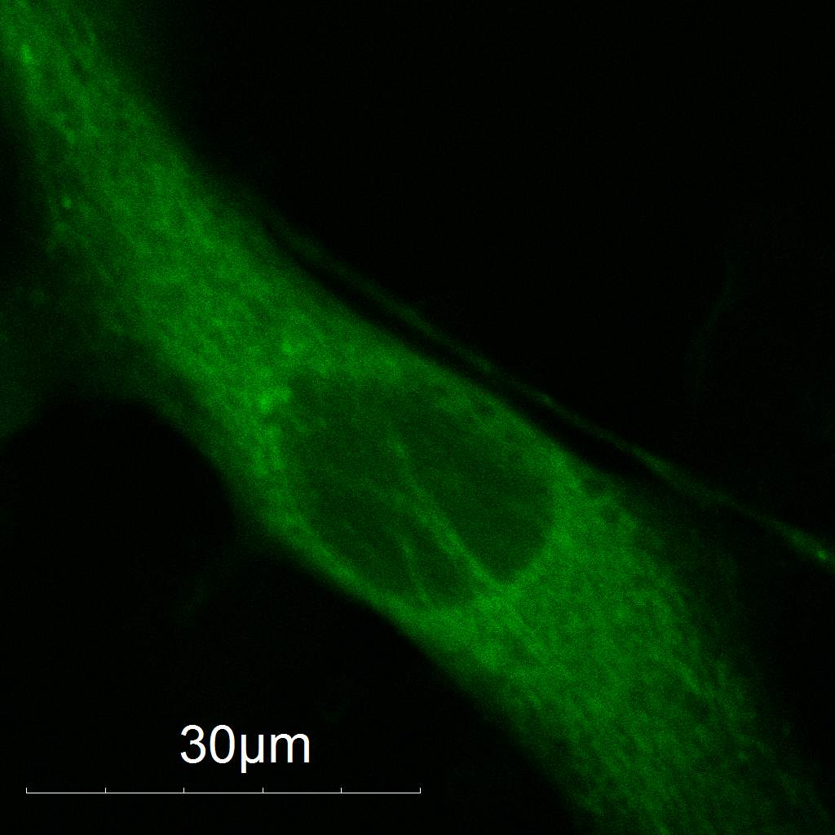
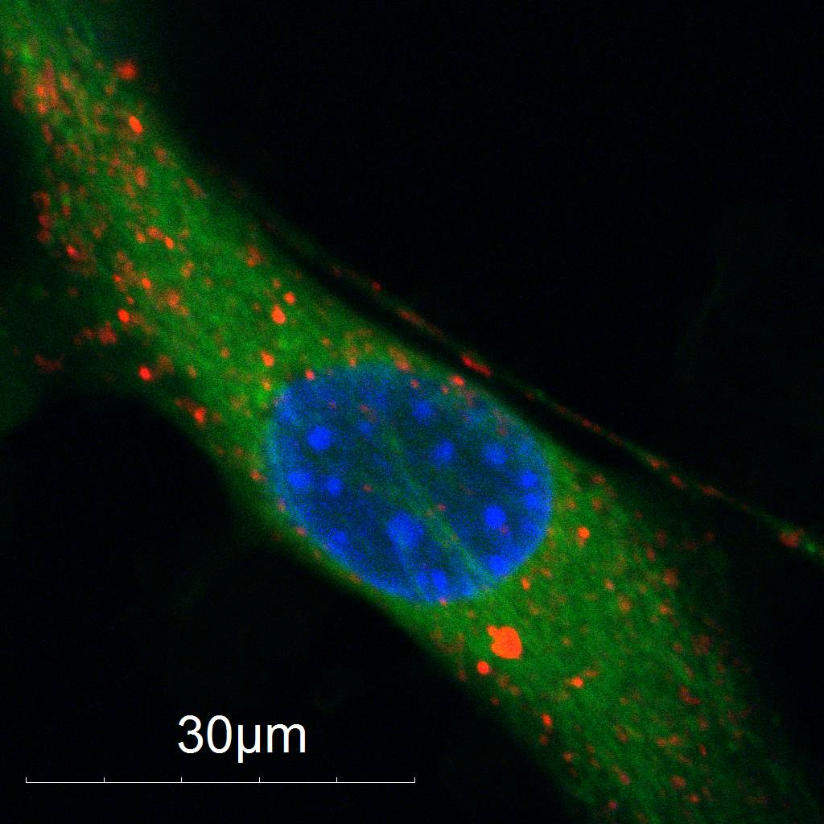
Co-localization of DSSQ1 with Lysotracker Red in NIH 3T3 Cells
A
B
NIH 3T3 cells were incubated for 30min in Hoechst, Lysotracker Red (LTR) ,and DSSQ1. Images of the live cells were taken on a Confocal Microscope. A is Hoechst a nuclear dye. B is LTR a lysosomal dye. C is DSSQ1 which stains the entire cell green. D is composite image of all three dyes . No co-localization can be seen through the lack of overlap of red and green colors. All images were taken under the same settings.
C
D
Notes:
5x (40x lens); 200-fold; doesn’t go to lysosome

Slide 3
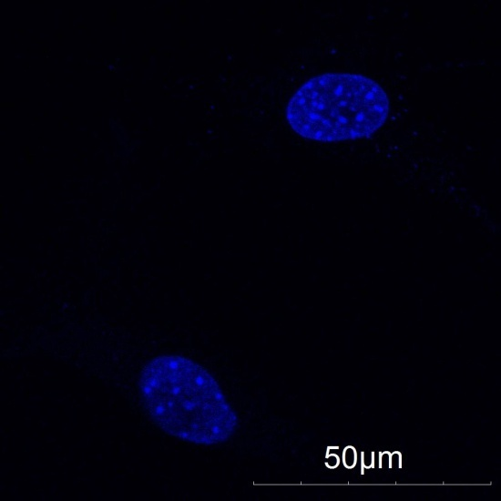
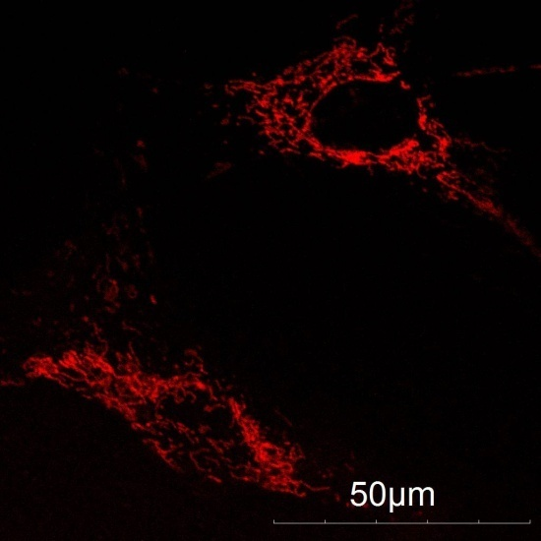
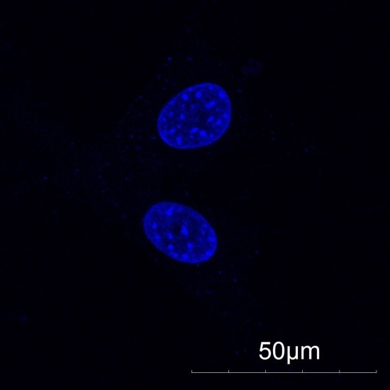
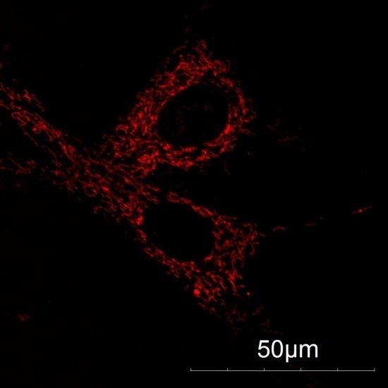
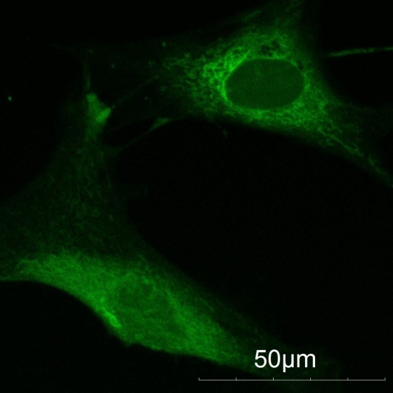
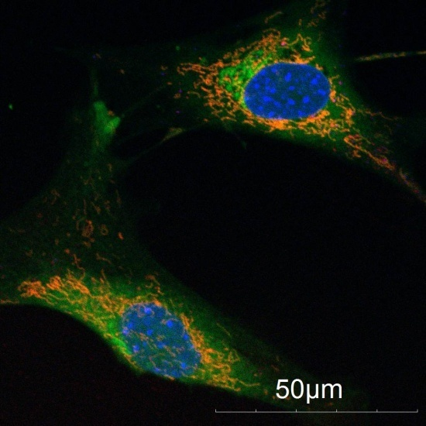
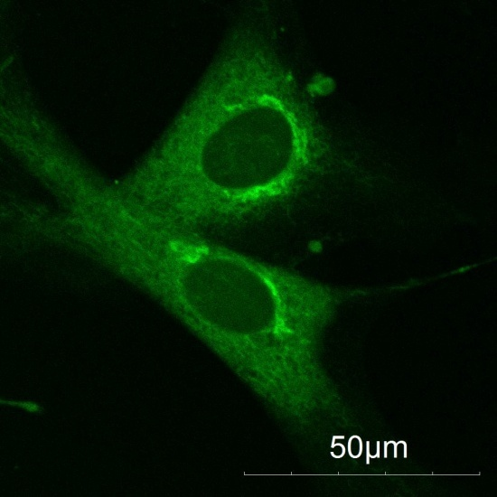
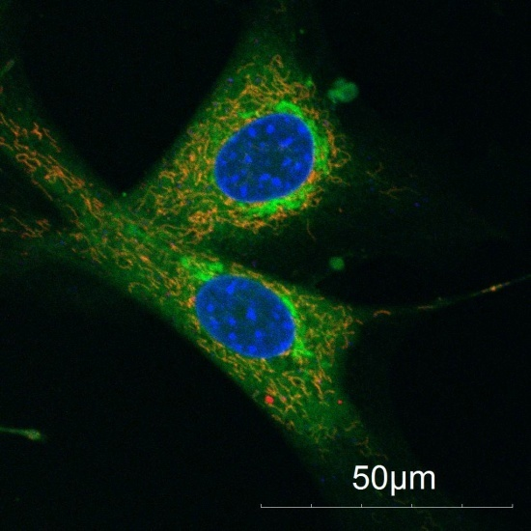
Effect of NAC pre-treatment on DSSQ1 Fluorescence in NIH 3T3 Cells
Control
10mM NAC
A
B
A
B
C
D
C
D
NIH 3T3 cells were treated with to a 30min 10mM NAC incubation. Cells were then incubated for 30min in Hoechst, TMRM ,and DSSQ1. Images of the live cells were taken on a Confocal Microscope. A is Hoechst a nuclear dye. B is TMRM a mitochondrial. C is DSSQ1 which stains the entire cell green. D is composite image of all three dyes . On the left is no treatment and on the right is with treatment. All images were taken under the same settings.
Notes:
Note: previous data with all-green nucleus was “non-pH controlled NAC”

Slide 4
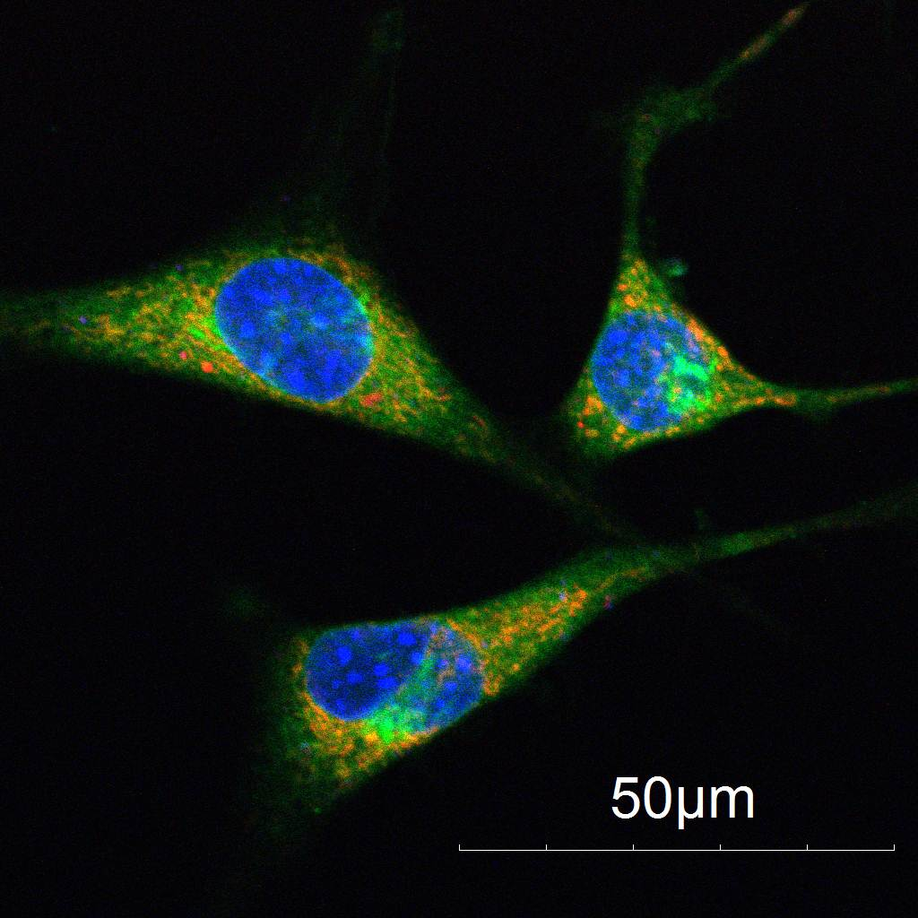
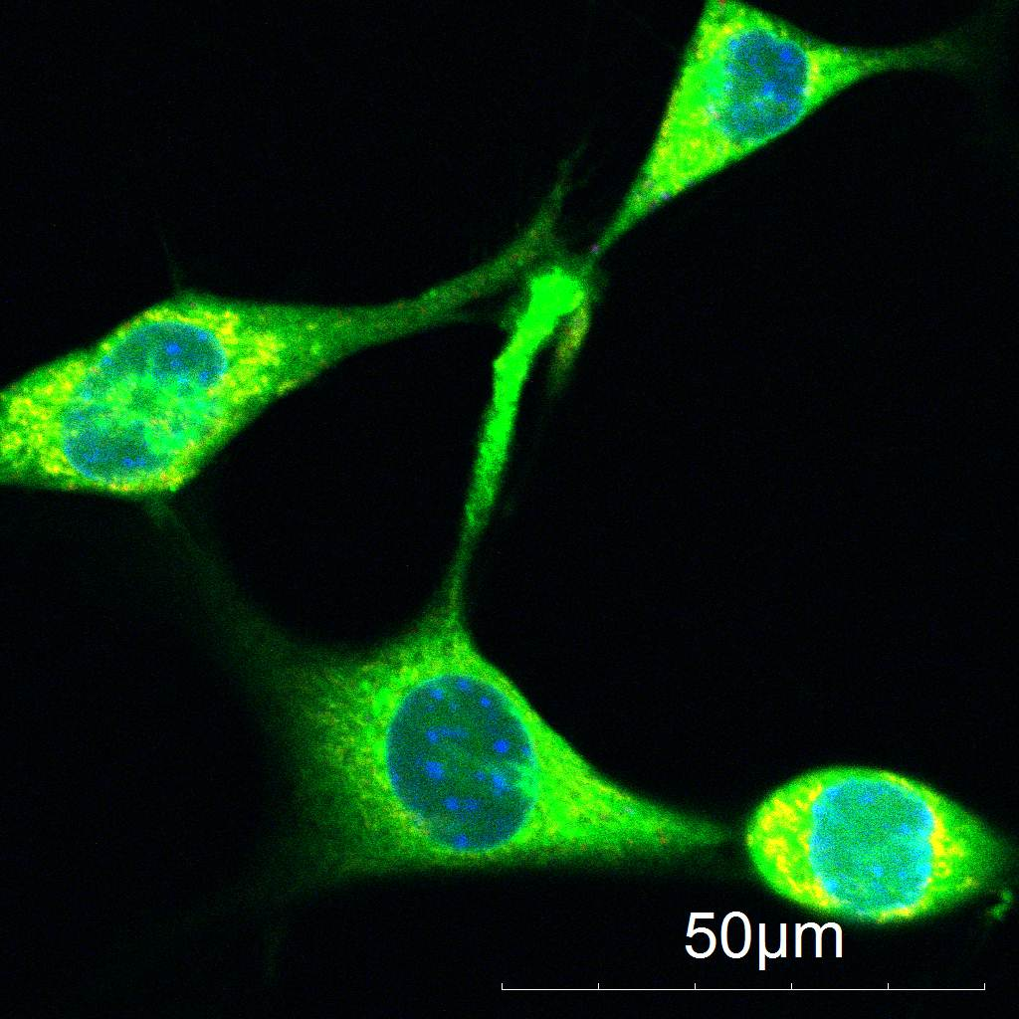
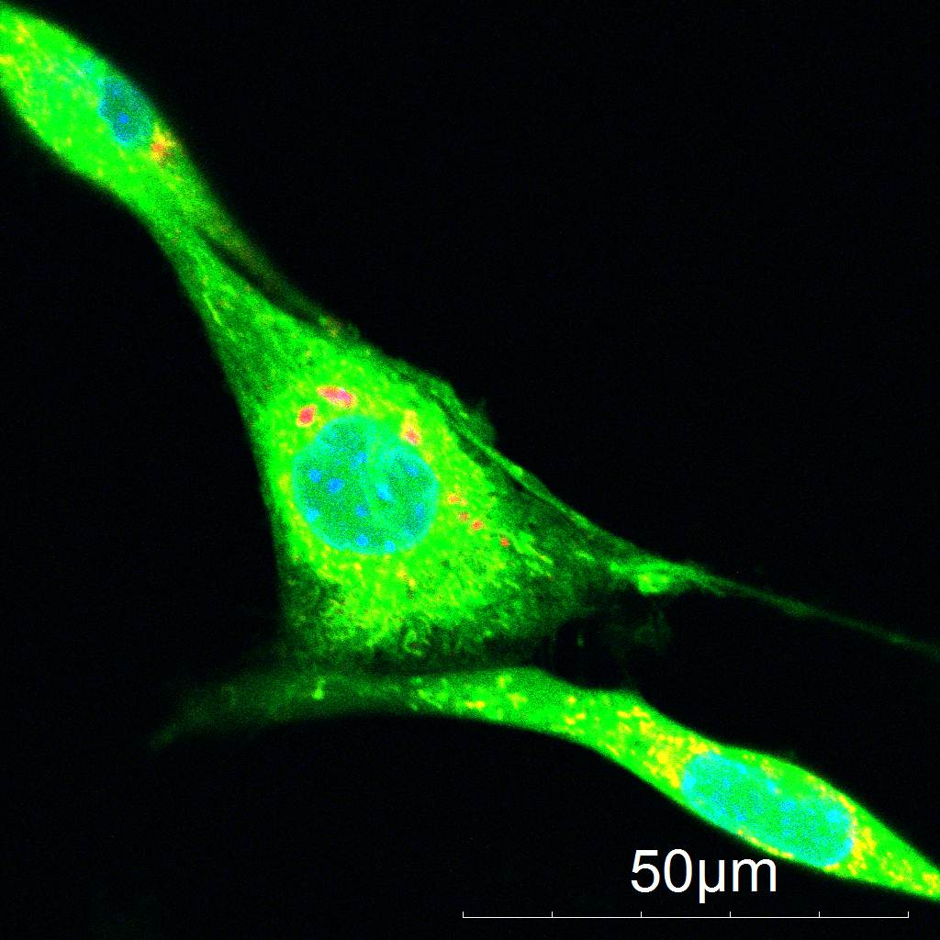
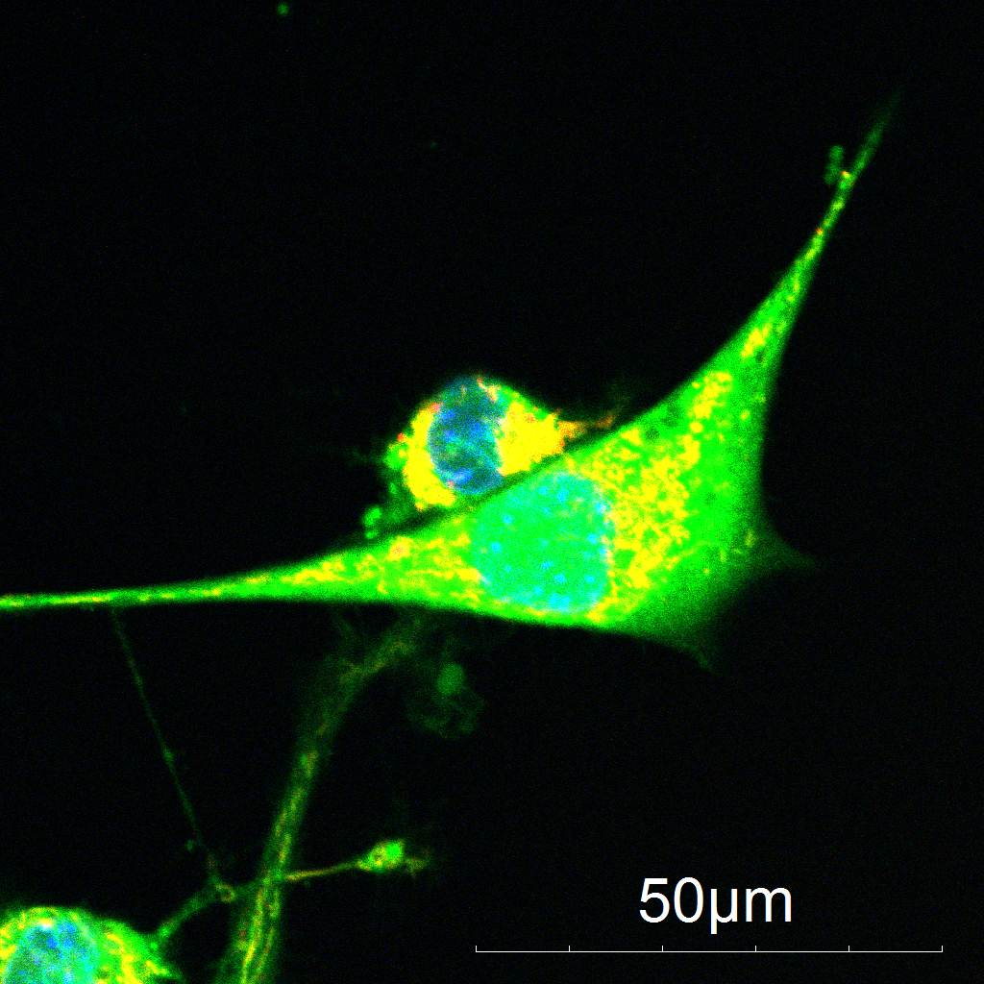
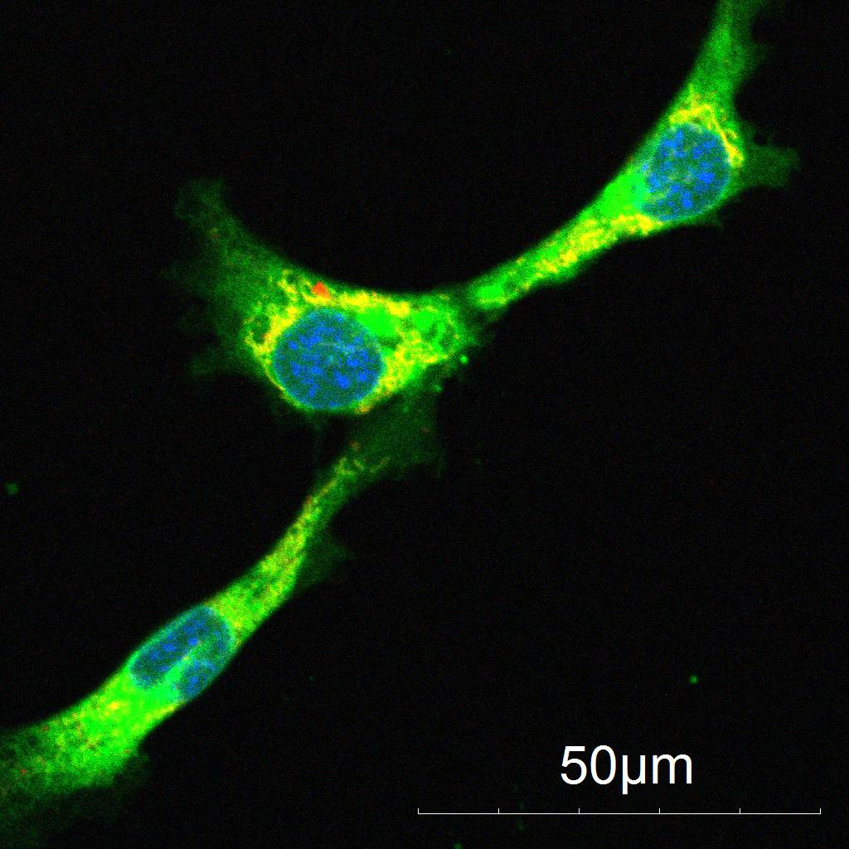
Effect of H2O2 pre-treatment on DSSQ1 Fluorescence in NIH 3T3 Cells
0uM H2O2
30uM H2O2
100uM H2O2
300uM H2O2
1000uM H2O2
NIH 3T3 cells were treated with to a 30min H2O2 incubation at varying concentrations. Cells were then incubated for 30min in Hoechst, TMRM ,and DSSQ1. Images of the live cells were taken on a Confocal Microscope. All images were taken at the same settings.

Slide 5
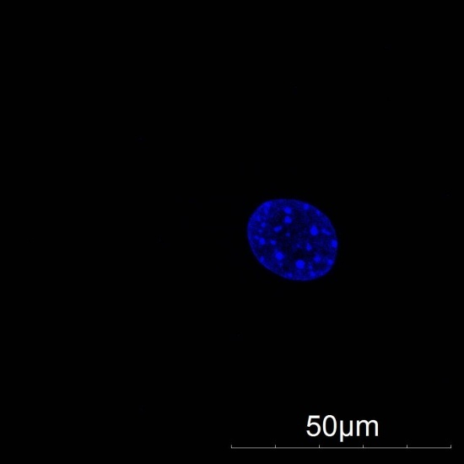
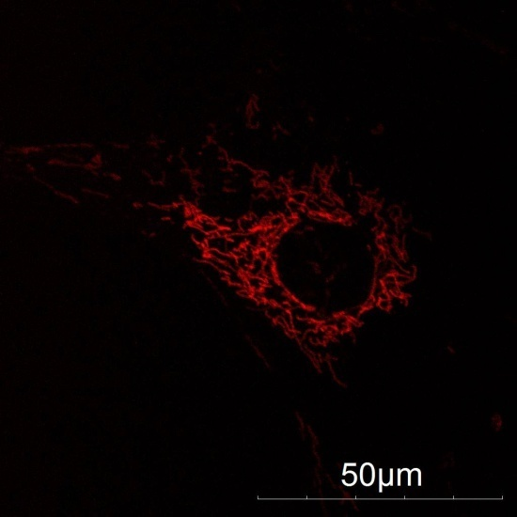
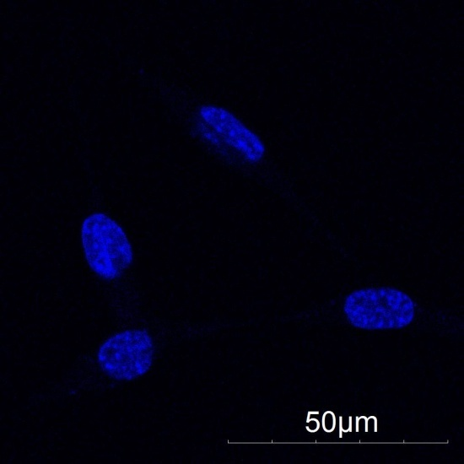
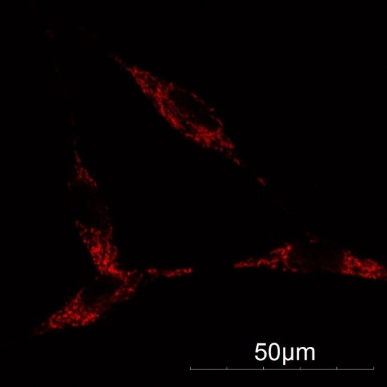
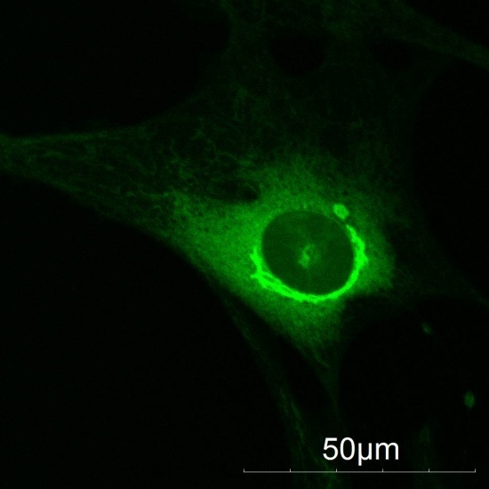
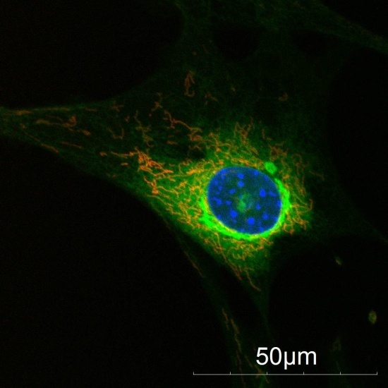
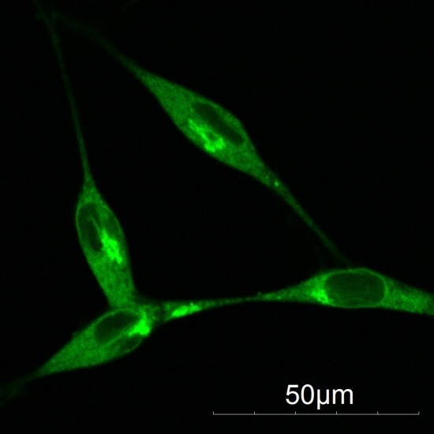
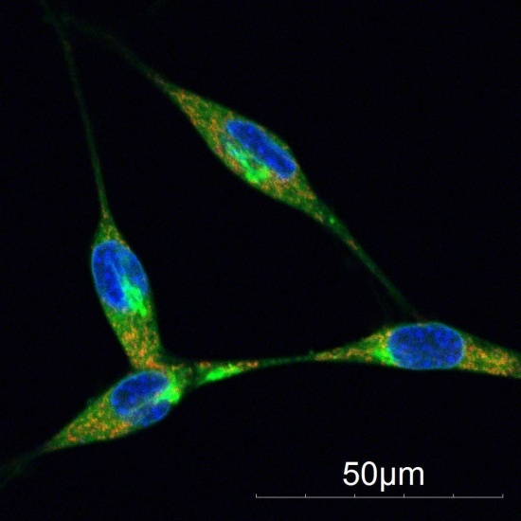
Application of DSSQ1 to Measure Differences in TGF- and TGF+ NIH 3T3 cells
TGF-
TGF+
A
B
A
B
C
D
C
D
NIH 3T3 cells were taken though TGF treatment protocols to obtain TGF+ and TGF- cell types. Both cell types were then incubated for 30min in Hoechst, TMRM ,and DSSQ1. Images of the live cells were taken on a Confocal Microscope. A is Hoechst a nuclear dye. B is TMRM a mitochondrial. C is DSSQ1 which stains the entire cell green. D is composite image of all three dyes . On the left is no treatment and on the right is with treatment. All images were taken under the same settings.

